Slide 1
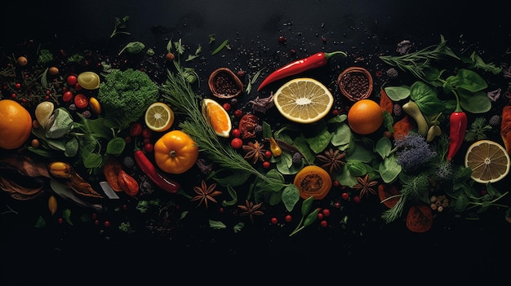

NeuralX 2026
Pure
Plate
Your Intelligent Nutrition Companion
TEAM LOGICLOOP
Team Leader-
Ninad Hazarika (ECB25018)
Team Members-
Anjanabh Goswami (ECB25009)
Chinmoy Hazarika (CSB25071)
Prabal Barman (FETM25003)
AI-Powered Health, Simplified — From Complex Labels to Clear Decisions in Under 5 Seconds
iOS • Android • Web
AI-Native Platform
February 2026

Slide 2
The Problem
Health Management is
Fragmented & Complex
App Overload
Label Confusion
Users juggle 5+ apps for BMI, calories, allergies, and meal planning — creating friction and confusion.
Technical jargon like "high fructose corn syrup" and "sodium benzoate" overwhelms consumers.
App Abandonment Rate
73%
220M
2-3 min
People with food allergies globally
ER visits from anaphylaxis
of users abandon health apps within 30 days
Most cannot identify common additives or allergens
Critical Gap: No real-time AI solution combines instant food interpretation with comprehensive health tracking
₹9365Cr
₹96870Cr
AI Nutrition by 2034
Digital Health 2025

Slide 3
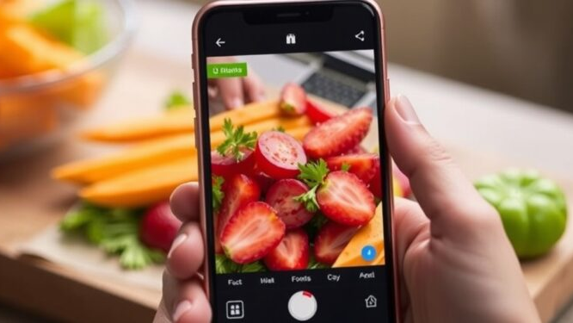
The Solution
One AI-Native Platform,
Complete Health
Transform complex health decisions into clear guidance in under 7 seconds
Search
Extract
Analyze
Personalize
Recommend
Search engine
Ingredients Knowledge
AI interprets data
Match user profile
Get clear guidance
< 7 Seconds from scan to insight
All-in-One Integration
BMI Calculator
Calorie Tracker
Allergy Shield
AI Suggestions

Slide 4

Features
Intelligence Meets Simplicity
Smart Food Search Bar
BMI & Calorie Tracker
AI SUGGESTIONS
Instant Searching with ingredient explanation and real-time allergy alerts.
Real-time tracking with user specific personalization and detailed macro breakdown.
Personalized meal plans with precise portions and smart alternatives for allergens.
< 7 seconds response
Protein
Carbs
Fats
Smart adaptation
Performance Metrics
AI Accuracy
91%
Allergy Shield & Safety Score
Clarity
Real-time alerts with safe food recommendation.
Gives a Score of the food Ingredients out of 100
The app uses graphs and points system to make it simply understood by everyone
Knowledge Base
10K+
Response Time
<7s
Instant alerts

Slide 5
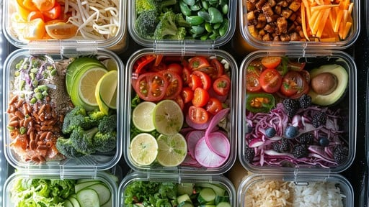
Strategy
Competitive Edge & Business Model
Only All-in-One Solution
B2B Network Model
1
B2B Memberships
Competitor | OCR | AI | Personalized | Real-time
Yuka
Fooducate
Open Food Facts
Nourish
PurePlate
Subscription revenue from health professionals
2
Government Fundings
Public health grants & partnerships
3
Platform Pitching
Showcasing health services & products
4
Advertising Revenue
Targeted ads for health brands
<7s
91%
10K+
Target Markets
Speed
Accuracy
Ingredients
Schools & Universities
Corporate Wellness
Healthcare Providers

Slide 6

Vision
Transforming Global Health
Our Impact
Roadmap
Q1-Q2
2026
Mobile App Launch
iOS & Android with core scanning
Safer Food Decisions
Accessible Knowledge
Global Database
Q3-Q4
2026
Empower 220 million allergy sufferers worldwide to make informed choices and reduce ER visits.
Democratize nutrition education by translating complex food science into understandable insights.
1M+ products, multi-language
2027
Wearable Integration
Smartwatch apps, CGM
2028+
B2B Platform
API platform, enterprise
Prevent Diseases
₹74,44,80,00,000
Help users avoid harmful additives, excessive sugars, and unhealthy fats to prevent obesity and diabetes.
Future Vision: AI Nutritionist
Potential healthcare cost savings by 10 years
Meal Planning
Grocery Integration
Restaurant Scanning
"Turning complex nutrition into clear, healthy decisions"
9864994660
https://pure-plate-ai.vercel.app/

